Slide 1
An acquisition project to engage audiences with
the issue of leprosy
Hannah Mudge, Digital Innovation Manager, The Leprosy Mission England and Wales
ENCC-X, 25-27 May 2021

Slide 2
Setting the scene
Previous online acquisition projects had been few and far between, with disappointing results. Why?
Lack of a compelling ask and story
Lack of public awareness about leprosy
Lack of capacity and budget
Lack of follow-up actions and tailored communication
2021 provided an opportunity to do something different
A UK Aid Match appeal to run from January-April
Our most ambitious campaign ever with more focus on digital than ever
Compelling stories and an exciting project could help us reach new audiences
ENCC-X, 25-27 May 2021

Slide 3
Goals
Key project goals
Generate new leads, especially from outside our ‘traditional’ supporter demographic (70+)
Combine Facebook lead generation with telemarketing to recruit new regular givers
Maximise support for UK Aid Match appeal
Test and learn to understand more about what motivates people to support our (niche, little-understood) cause
ENCC-X, 25-27 May 2021

Slide 4
Enter Forward Action
Together we worked on:
Three optimised handraisers with post-action donate asks
An email welcome series with a variety of content including a survey, quiz, stories and videos
Facebook ads (732 ads across 28 ad sets in the end!)
ENCC-X, 25-27 May 2021

Slide 5
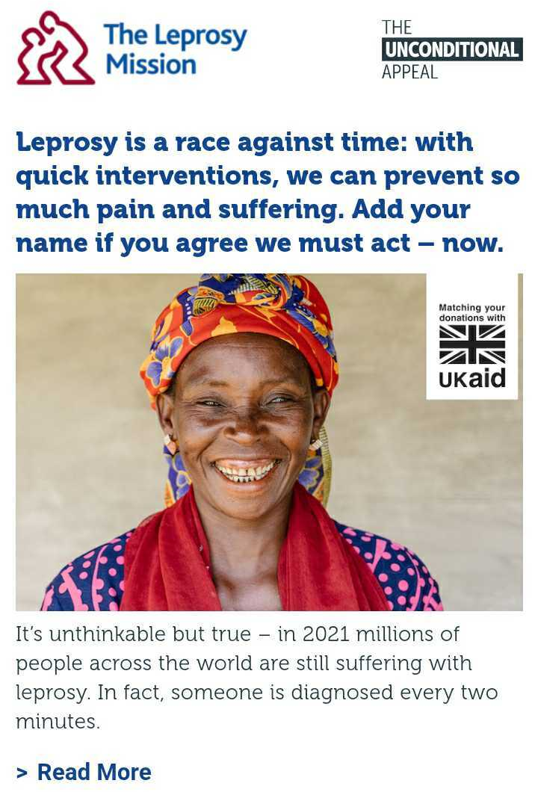
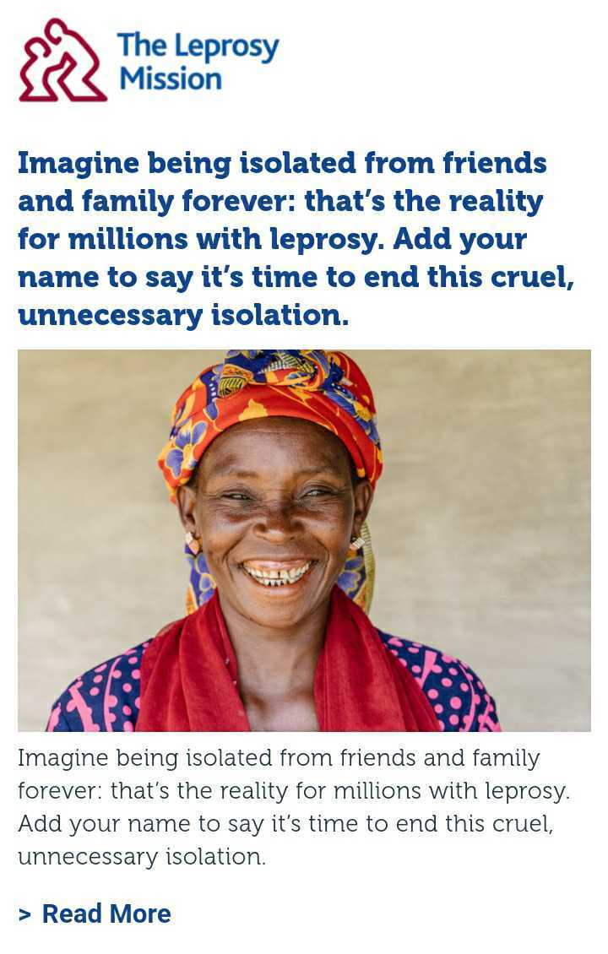
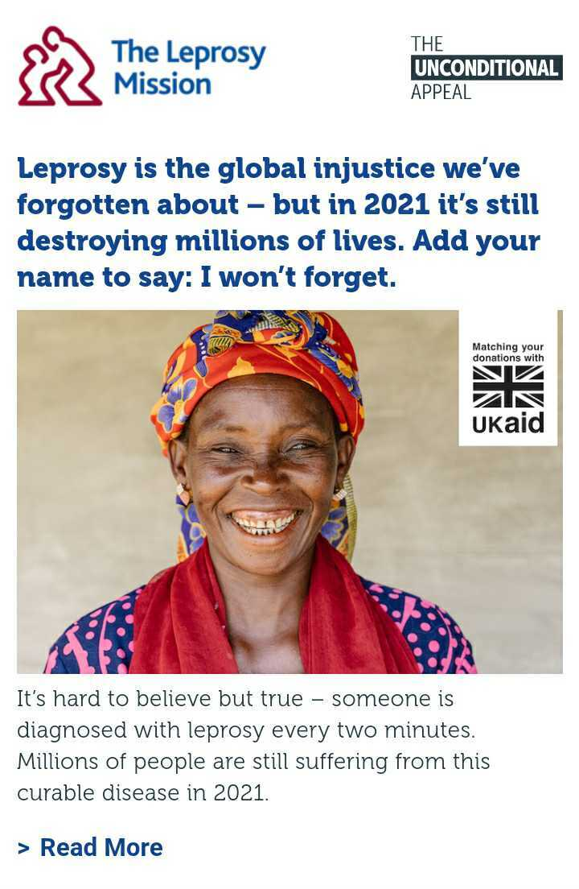
Handraisers
1: Urgency
2: Isolation
3: Injustice
ENCC-X, 25-27 May 2021

Slide 6
Handraiser test
‘Isolation’ was the winning theme
Urgency
Cost per signature: £1.66
Cost per opt-in: £2.47
Injustice
Cost per signature: £1.19
Cost per opt-in: £1.96
Isolation
Cost per signature: £0.38
Cost per opt-in: £0.59
ENCC-X, 25-27 May 2021

Slide 7
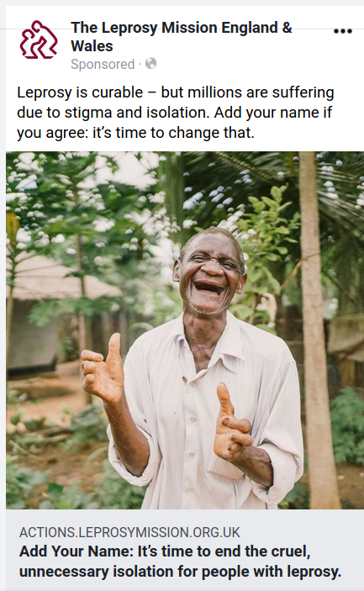
Copy and image tests
We tested a variety of images - men and women, happy and neutral facial expressions, images of healthcare professionals and people affected by leprosy
Jorge’s photo proved to be the most successful in two out of three tests
Mario’s photo came out on top in the final test (which was targeting audiences with an interest in science and medicine)
Copy that worked was:
Solution-focused
Had a sense of urgency
Showed a clear call to action
ENCC-X, 25-27 May 2021

Slide 8
Further tests
Donation page tests included:
Including a totaliser to show total amount raised by the appeal so far
Toggling regular gift/single gift tabs to front and back
Hiding longer copy
Removing the Aid Match logo
Audiences:
Lookalikes
International development interests
Science and Medicine interests
Faith-based interests
Christian women aged 45-60
Telemarketing:
Varying first ask amount
Looking at how different audiences performed
ENCC-X, 25-27 May 2021

Slide 9
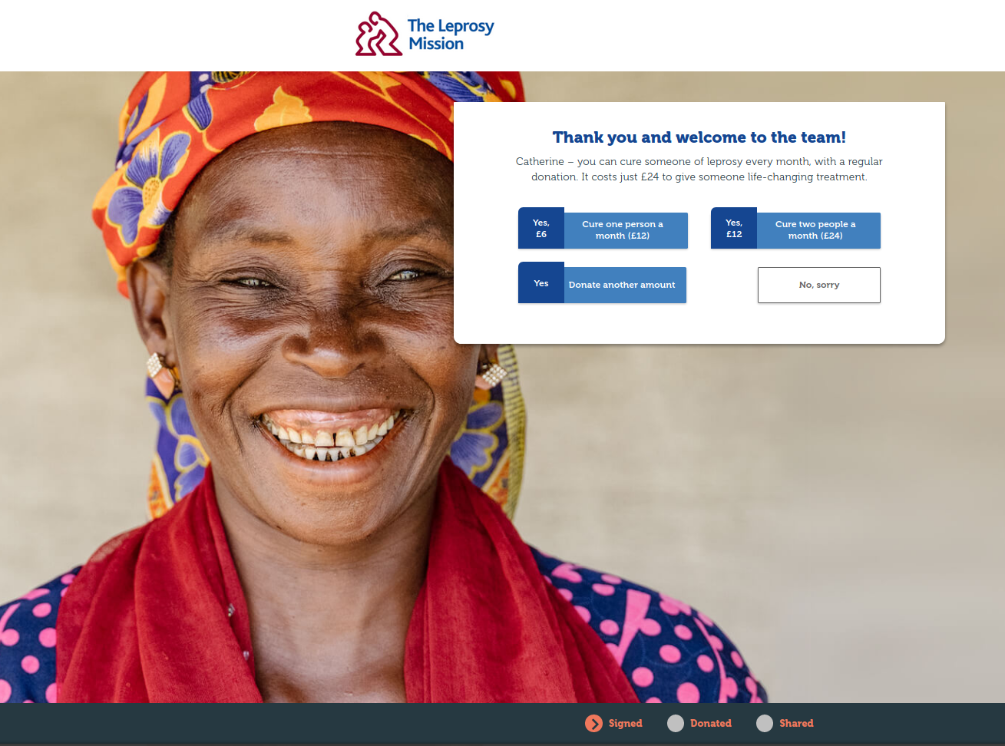
Post action activity
Donation ask following handraiser sign-up gave us amazing results
2.22% of leads gave a cash gift, well above the Forward Action benchmark of 0.75-1%
0.13% of leads set up a regular gift
Open rates for email series were between 33.6-39.4%
0.59% of leads gave a gift as a result of an ask in the email series, again above the FA benchmark of 0.04-0.12%
0.09% set up a regular gift as a result of an email
ENCC-X, 25-27 May 2021

Slide 10
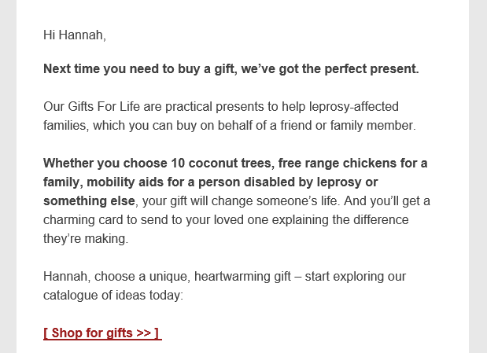
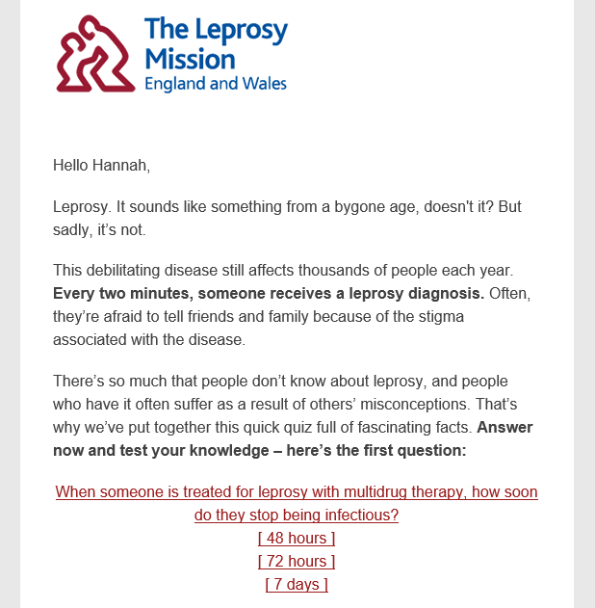
Emails
ENCC-X, 25-27 May 2021

Slide 11
Results
Donations
291 cash gifts (average gift £19.90)
73 regular gifts (average monthly gift £8)
258.65% return on ad spend
Engagement
7,000 new email optins
Some of these have already given again to the Aid Match campaign and India Emergency Appeal
22% on page conversion to donation for petition signers
ENCC-X, 25-27 May 2021

Slide 12
Thank You.
hannahm@tlmew.org.uk
ENCC-X, 25-27 May 2021

